Slide 1
FOSSILS AND ITS TYPES
Created By
AASIA RASHID BHAT
Assistant Professor
Department of Botany
Govt. P.G College Rajouri

Slide 3
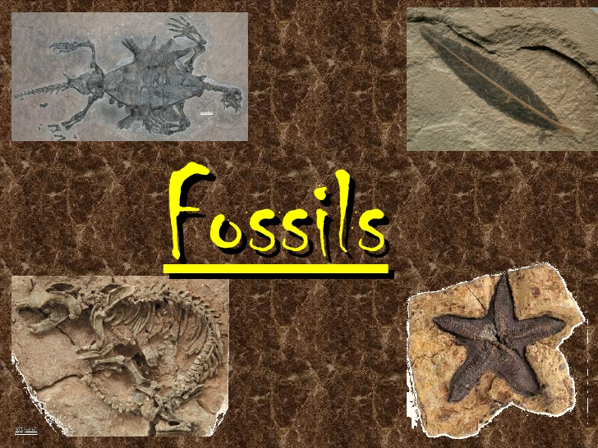
fossils

Slide 19
THANKS

